Slide 1
TITLE PAGE
Problem Statement ID – Question 4A
Problem Statement Title – AI-Powered Behavioral Anomaly Detection for Cybersecurity
Theme – Cybersecurity & Data Analysis
PS Category – Software
Student Name – Ravi Kishan
Student ID – 23BDS0227 (Vellore Institute of Technology, Vellore)

Slide 2
SentinelLens — Explainable Behavioral Anomaly Detection
Proposed Solution (Describe your Idea/Solution/Prototype)
Learns per-entity “normal” behavior (users, service accounts, edge devices) from access logs — then flags deviations in near real-time
Classifies the attack type — brute force, impossible travel, credential stuffing, lateral movement, device spoofing, low-and-slow exfiltration — not just “anomalous”
Every alert ships with a SHAP-based plain-English rationale (e.g. “16 accounts from one IP + failed auths”) — built for SOC analysts, not black-box scores
Addresses signature-based security's blind spot: novel and slow attacks that match no known malware hash or fixed rule
Uniqueness: 0% false positives on brand-new entities AND on legitimate behaviour change — the two failures that make real SOC tools unusable

Slide 3
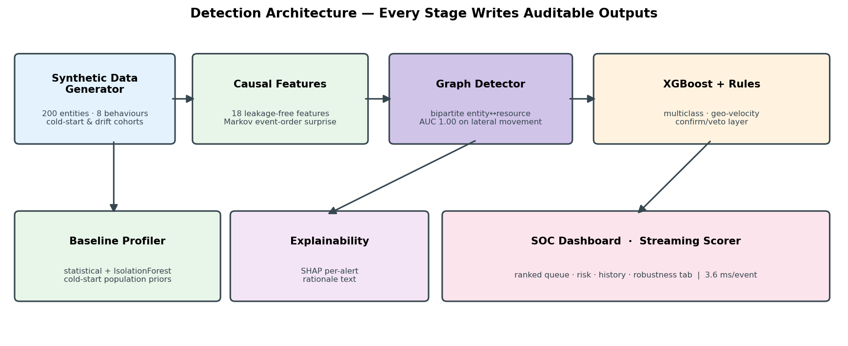
TECHNICAL APPROACH
Technologies to be used (e.g. programming languages, frameworks, hardware)
Python · pandas/NumPy · faker · XGBoost · SHAP · Streamlit · Plotly
Generator matches the spec schema and all 8 behaviour patterns — 200 entities, 74K sessions, OS+MAC+protocol fingerprints, no giveaway values
Sequence-aware detection via GRAPH model (spec option 3): bipartite entity↔resource graph, peer affinity + 2-hop reachability — AUC 1.00 on lateral movement
XGBoost multiclass + physics rule layer that CONFIRMS and VETOES geo-velocity claims; time-based split; inverse-frequency weighting
Baseline profiler (statistical + IsolationForest) · SHAP rationale per alert · Streamlit dashboard · 3.6 ms/event streaming scorer

Slide 4
FEASIBILITY AND VIABILITY
Analysis of the feasibility of the idea
Feasibility — proven, not promised:
Working end-to-end pipeline on 73,931 sessions; live scoring at 3.6 ms/event (277 events/sec, single thread)
PR-AUC 0.996 at 1:42 imbalance; 0 false alarms/day at a top-1% analyst budget; 50,271 events/sec batched
Challenges & risks — identified honestly:
Results are measured on SYNTHETIC traffic and are optimistic by nature — 3 inflating artifacts were found and removed during development
Measured on purpose-built cohorts: 20 brand-new entities (2,647 sessions) + 18 entities that legitimately changed shift and device
Mitigation strategies:
0.00% false positives on both cohorts; rolling baselines re-learn the new normal (post-drift deviation 0.85, identical to unchanged entities)
Physics rule layer confirms AND vetoes impossible travel → that class improved 0.83 → 0.93 F1
Streaming demonstrated by per-event benchmark; causal features port directly to Kafka-style stateful processing

Slide 5
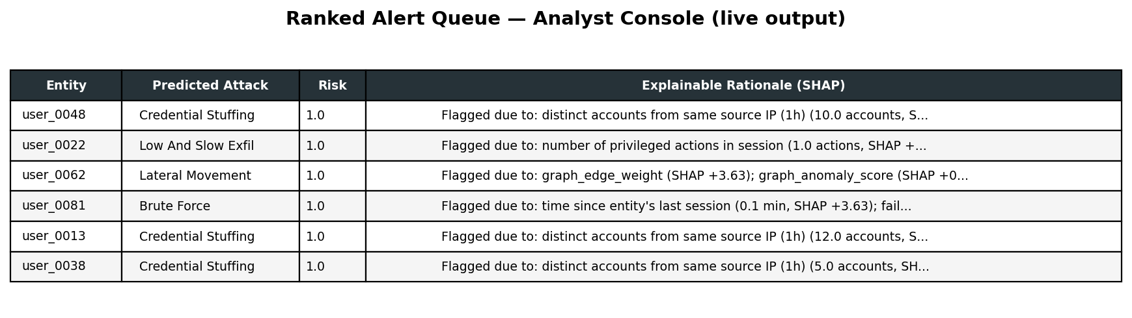
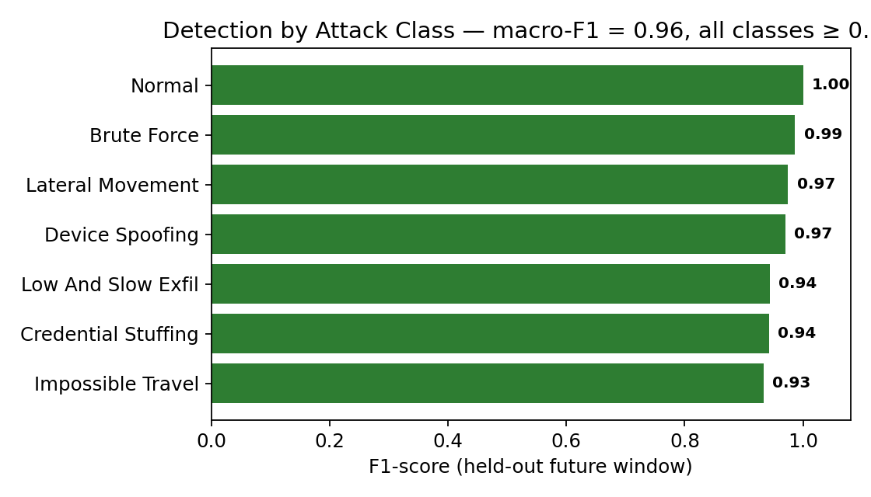
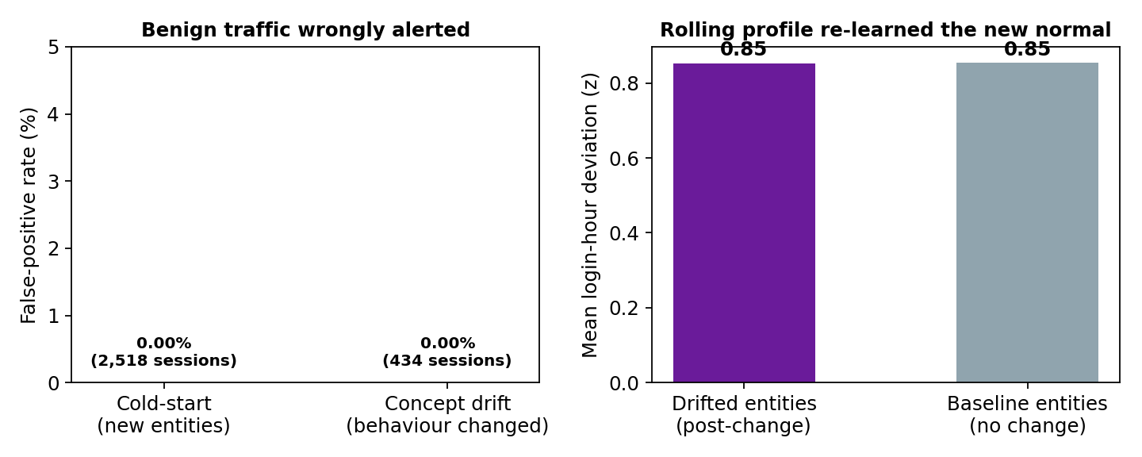
ARTIFACTS
Relevant artifacts, such as :
GitHub repo: full source — generator, features, model, SHAP layer, dashboard (setup + run order documented)
Live outputs below: real alert queue with SHAP rationales · per-class F1 · precision-recall vs. analyst alert budget

Slide 6
RESEARCH AND REFERENCES
Details / Links of the reference and research work
- Lundberg & Lee (2017), "A Unified Approach to Interpreting Model
Predictions" (SHAP) — NeurIPS 30 — https://arxiv.org/abs/1705.07874
- Chen & Guestrin (2016), "XGBoost: A Scalable Tree Boosting System"
— KDD '16 — https://arxiv.org/abs/1603.02754
- Chandola, Banerjee & Kumar (2009), "Anomaly Detection: A Survey"
— ACM Computing Surveys 41(3) — https://doi.org/10.1145/1541880.1541882
- Liu, Ting & Zhou (2008), "Isolation Forest" — IEEE ICDM
— https://doi.org/10.1109/ICDM.2008.17
- MITRE ATT&CK® — adversary tactics & techniques taxonomy
— https://attack.mitre.org
- NIST SP 800-94, "Guide to Intrusion Detection and Prevention Systems"
https://csrc.nist.gov/pubs/sp/800/94/final
- CERT/SEI, "Common Sense Guide to Mitigating Insider Threats"
— https://www.odni.gov/files/NCSC/documents/nittf/20180209-CERT-Common-Sense-Guide-Fifth-Edition.pdf
SHAP (NeurIPS): https://proceedings.neurips.cc/paper/2017/hash/8a20a8621978632d76c43dfd28b67767-Abstract.html
XGBoost (ACM DOI): https://doi.org/10.1145/2939672.2939785
Anomaly survey (free PDF): https://vs.inf.ethz.ch/edu/HS2011/CPS/papers/chandola09_anomaly-detection-survey.pdf
https://vs.inf.ethz.ch/edu/HS2011/CPS/papers/chandola09_anomaly-detection-survey.pdf
Deployed link on streamlit: [https://behavioral-anomaly-detection-abkuajnmz3kmxlwwluxhbm.streamlit.app/]
GitHub repository link: [https://github.com/rkKishan/Behavioral-Anomaly-Detection.git]

